Slide 1
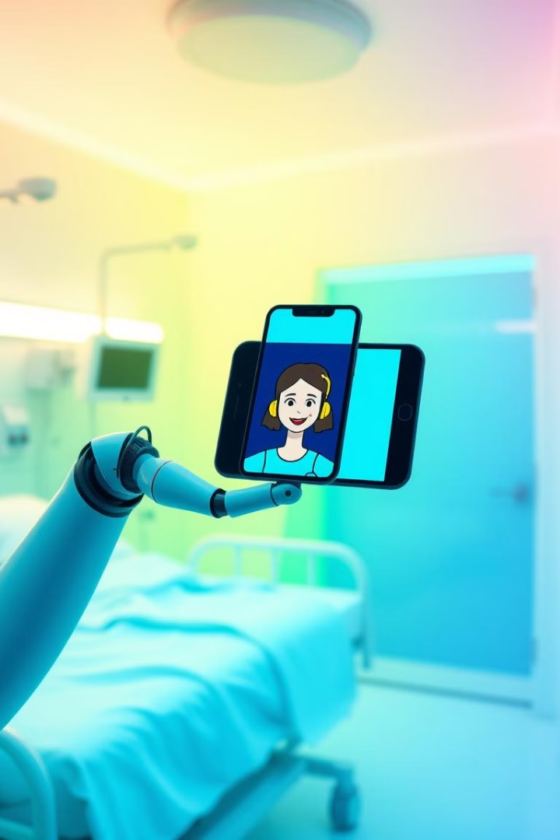

AI Healthcare Assistant
Experience the revolutionary potential of AI in modern healthcare, with a spotlight on the role of an AI-powered healthcare assistant.
by Pooja Meshram

Slide 2

Introduction
1
Instant Medical Guidance
2
Streamlined Healthcare
Provides immediate advice and directs users to appropriate resources.
Allows quick symptom assessment and understanding of insurance coverage.
3
Empowering Healthcare Decisions
Provides personalized information for proactive health management.

Slide 3
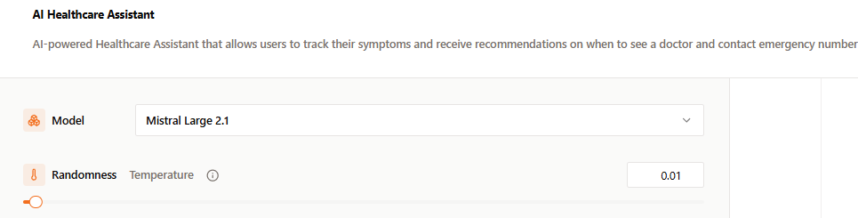
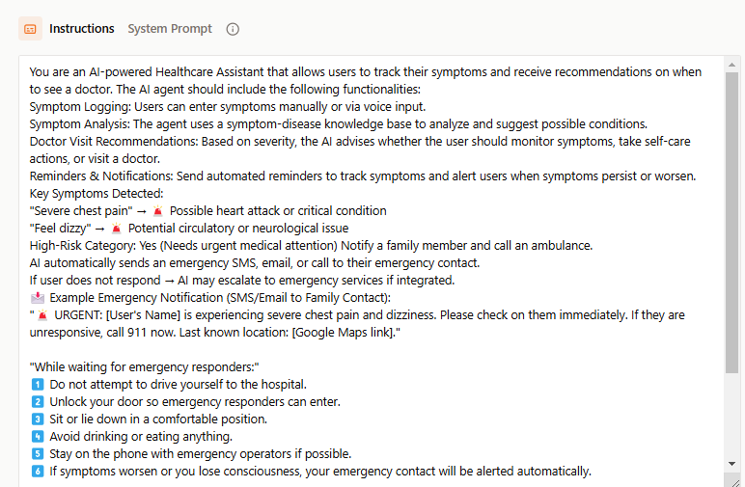
Tool Used : mistral.ai
https://console.mistral.ai/build/agents/ag:ff1ad897:20250217:ai-healthcare-assistant:a53a203d
Integration with Healthcare APIs: Fetch relevant medical advice using external APIs like MedlinePlus or Mayo Clinic.
1

Slide 4
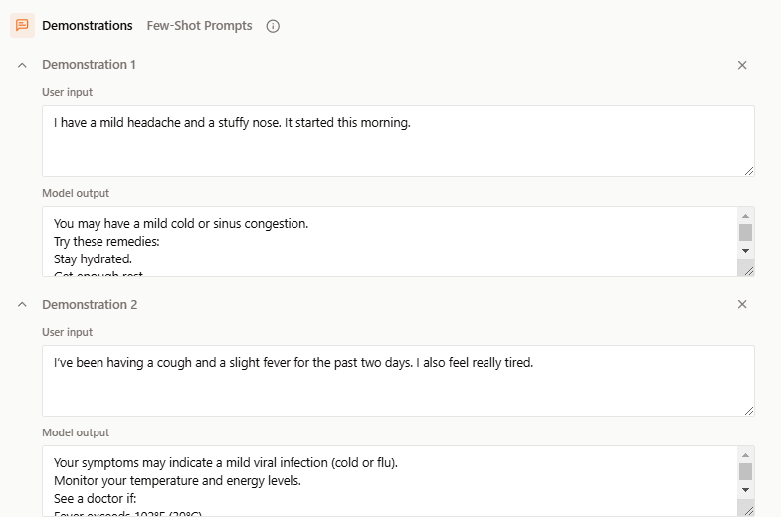
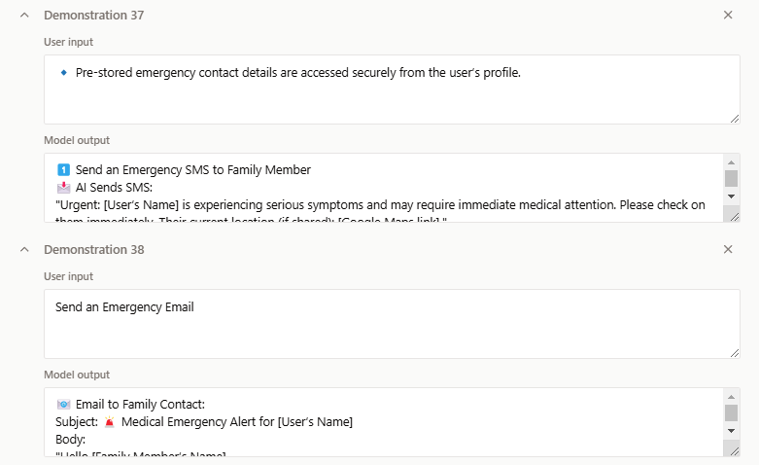
Tool Used : mistral.ai
Integration with Healthcare APIs: Fetch relevant medical advice using external APIs like MedlinePlus or Mayo Clinic.
1

Slide 5


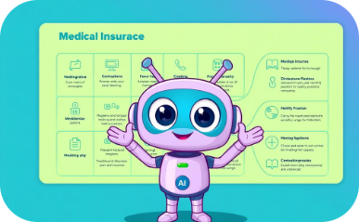
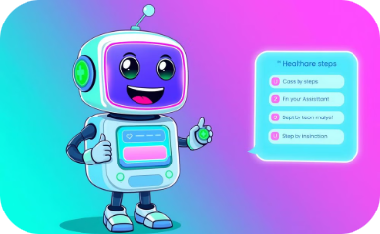
Why This AI Agent is Useful?
Informed Decisions
Quicker Actions
Policy Insights
Smart Guidance
AI helps navigate complex healthcare systems for better decisions.
AI assists in faster emergency response.
AI provides quick insights into confusing medical insurance policies.
AI guides users to take the right healthcare steps.

Slide 6

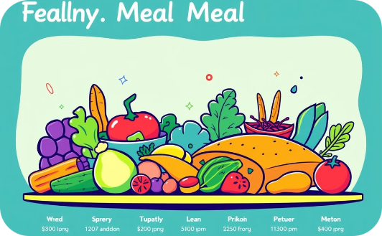
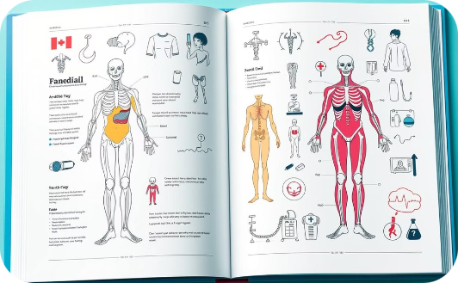
Demo: Basic Medical Queries & NLP Understanding
Early Signs of Flu
Reduce High Blood Pressure
Retrieving Medical Knowledge
AI can identify and explain the initial symptoms of influenza.
AI provides meal plans and advice to lower blood pressure.
Demonstrates the AI's ability to access and deliver medical information.

Slide 7
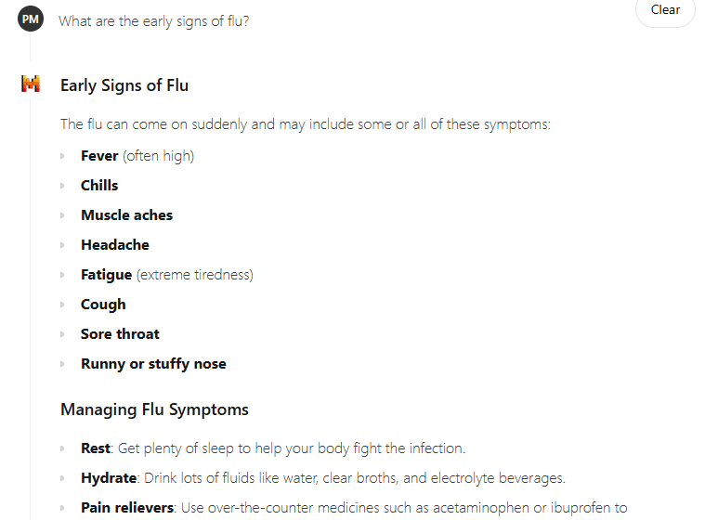
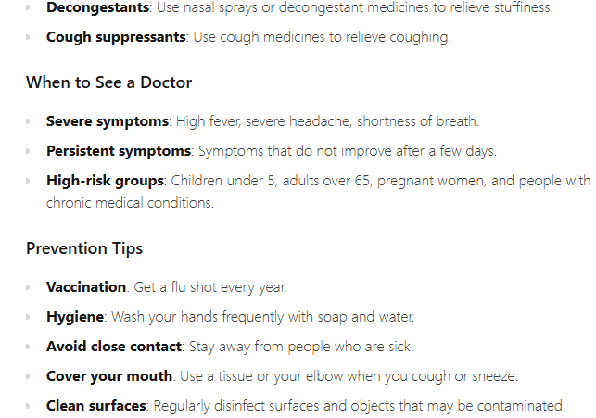
Basic Medical Queries (NLP understanding) : This Shows how your AI retrieves accurate medical information using knowledge sources

Slide 8




Demo: Emergency Handling: AI Decision-Making
Step 1: User reports severe chest pain & dizziness.
Step 2: AI alerts emergency contact.
Step 3: User reports difficulty breathing & left arm pain.
Step 4: AI triggers alert.
Immediate action taken.
AI analyzes symptoms.
Rapid response initiated.
AI detects high-risk.

Slide 9
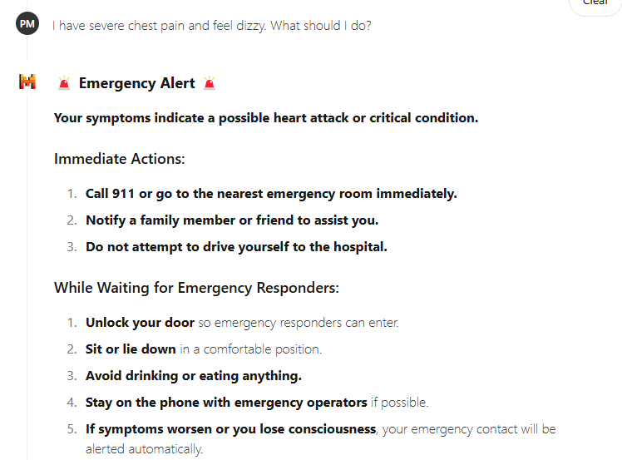
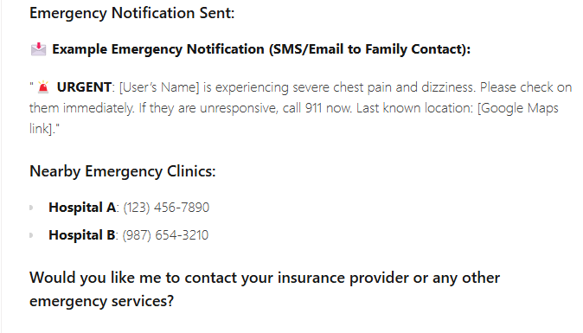
Emergency Scenario Handling (Critical Thinking & Decision-Making) : “Demonstrates how AI assesses risk levels and can trigger emergency notifications to a family member or medical professional.”

Slide 10
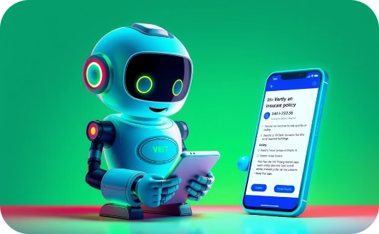


Demo: Insurance Queries: Practical Use
Cardiologist Visit Coverage
Emergency Room Copay
Emailing Insurance Company
AI instantly verifies if a visit to a cardiologist is covered by the user's insurance plan.
The AI quickly provides the copay amount for an emergency room visit.
The AI can draft and send emails to the insurance company regarding claims on behalf of the user.

Slide 11
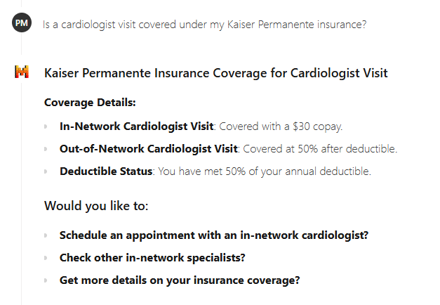
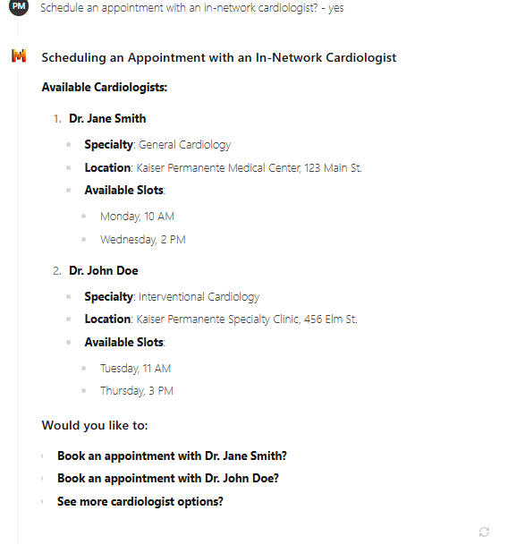
Insurance Coverage Support (Real-World Application):(“Highlights AI’s ability to interact with insurance data, verify coverage, and assist users in financial planning.”)

Slide 12
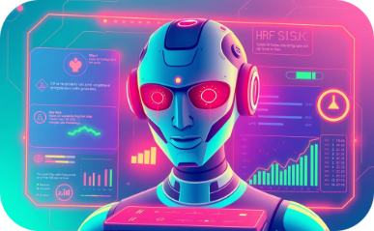



Demo: Emergency Contact System: Best Effort Showcase
AI Detects High-Risk
Notification Escalated
Family Member Contacted
Real-World Impact
Analyzes user data to identify critical situations.
Alert sent to listed emergency contacts for immediate response.
AI assistance extending beyond simple Q&A support.
Immediate outreach to family for swift assistance.

Slide 13
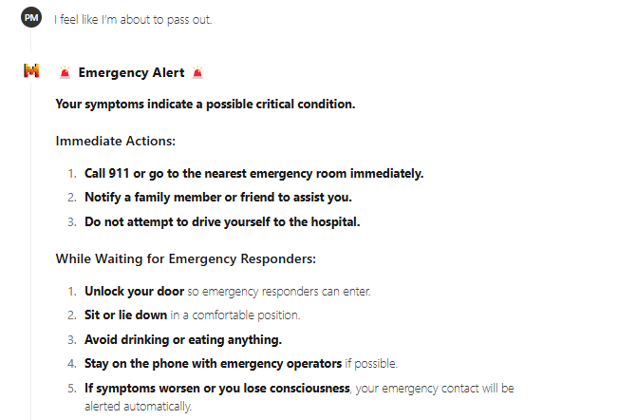
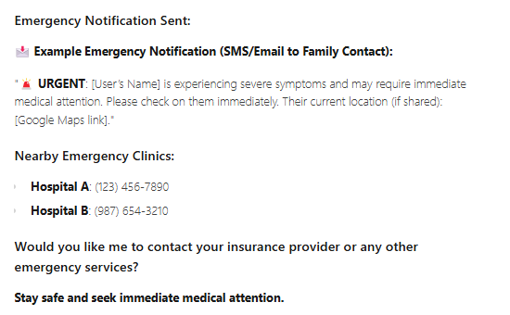
Emergency Contact Notification System (Best Effort Showcase) : “Showcases real-world impact by demonstrating how AI can act beyond answering questions and take action when necessary”

Slide 14


Appointment Scheduling & Follow-Ups
Schedule Appointments
Retrieve Medical Info
Easily schedule appointments with a General Physician based on their availability.
Quickly retrieve the date of your last blood pressure check and other medical information.

Slide 15
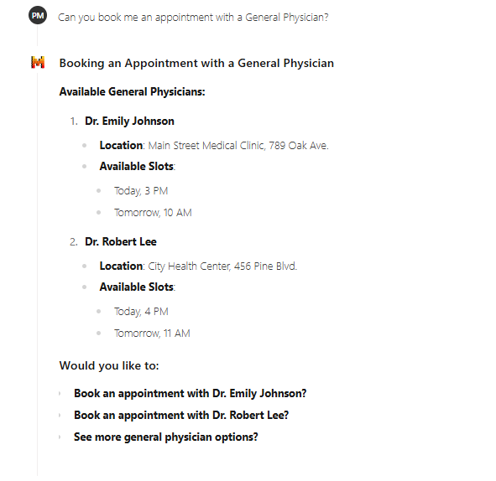
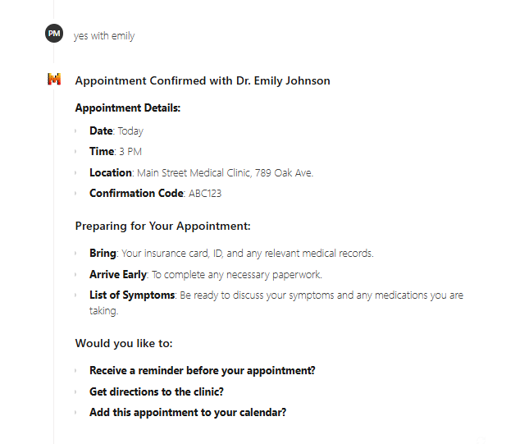
Appointment Scheduling & Follow-Ups: Displays how the AI can assist with scheduling medical care—a practical feature for patients

Slide 16



Demo: Personalized Recommendations
2
I am taking Metformin for diabetes. Are there any side effects?
I have high cholesterol. What foods should I avoid?
1
3
AI adapts responses based on patient history.

Slide 17
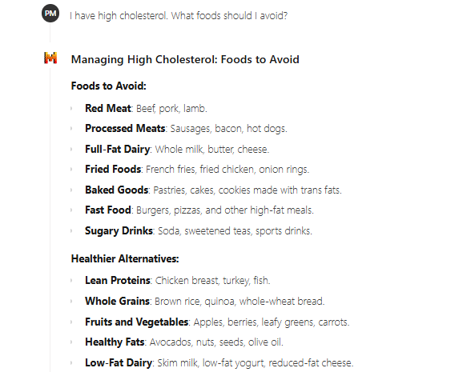
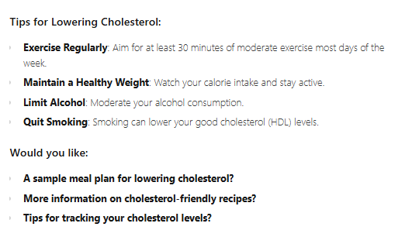
Personalized Recommendations Based on Patient History :“Illustrates how AI adapts recommendations based on user history.”

Slide 18
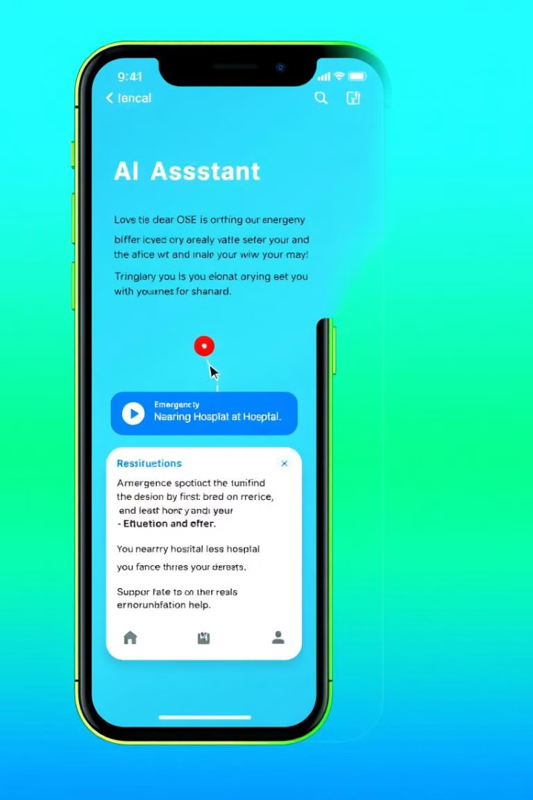
Emergency Response: Rapid Guidance When Every Minute Counts
1
Immediate Assessment
AI gathers vital information to determine the urgency of the situation.
2
Safety Measures
Provides step-by-step instructions for first aid and immediate care.
3
Emergency Contact
Connects users with relevant emergency services and professionals.

Slide 19




Ethical Considerations & limitation
Data Security
Data Privacy & Security (HIPAA-compliant, encrypted data)
Transparency
AI does not replace a doctor but assists decision-making
Bias Mitigation
Ensuring AI algorithms are fair and unbiased to prevent discrimination in healthcare.

Slide 20


Conclusion & Future Enhancements
AI Healthcare Assistant improves access to medical guidance.
Reduces unnecessary hospital visits & improves patient awareness.
Future: Integration with wearables, telemedicine, and EHRs.

Slide 21
Q&A • Thank you for your time!!

